Slide 1

2013 Con Alma Health Foundation
Pre-Proposal Presentation

Slide 2
Mission
Be aware of, and respond to, the health rights and needs of the culturally and demographically diverse people and communities of NM;
Improve health status and access to health care services, and
Advocate for health policy that will address the health needs of all New Mexicans

Slide 3
Core Values
To improve the health status of all New Mexicans;
To maintain the public trust;
To involve, collaborate, and partner with New Mexico communities;
To innovate and lead;
To teach and learn; and
To be an active advocate for health policy that supports CAHF’s charitable purpose and mission.

Slide 4
Health Includes (CAHF Definition):
Health is more than health care
Con Alma Health Foundation defines health broadly to include components of:
Environmental health
Psychological, emotional & behavioral health
Social and economic health
Oral health
Spiritual health and well-being

Slide 5
Levels of Change
Micro level
Direct Services Focus
Macro level
Systems Change Focus
Individuals & Families
Example: funding a clinic for health care services for individuals and families
Communities
Systems (e.g. health system, workforce system, etc.)
Example: Patient Protection & Affordable Health Care Act (health care reform)

Slide 6
Systems Change
Direct services focus on individuals, families or small groups
Systems change moves beyond individuals, individual organizations, single problems and single solutions
It involves thinking about systems (e.g. health care system, economic system, educational system, environmental system) in order to impact a larger group, community or society

Slide 7
Levels of Focus
Systems
(e.g. health care)
Community
Groups & Organizations
Individuals and Families

Slide 8

Health Equity in NM: A Roadmap for Grantmaking & Beyond Visit www.conalma.org for CAHF 2013 Grantmaking Priorities

Slide 9
Health Equity in New Mexico: A Roadmap for Grantmaking and Beyond Key Findings
1. Improved conditions and policies that address SDOH and advance health equity, especially among racially and ethnically diverse and underserved populations, can significantly improve health in NM.
2. Access to quality and affordable health care services continues to be a barrier to good health, especially in rural NM, communities of color, and underserved populations.
3. Prevention, nutrition, health promotion & holistic health are critical to improving health in NM.
4. Our rapidly changing environment, including demographic shifts, will have major implications in health for New Mexico.

Slide 10
RECOMMENDATIONS FOR GRANTMAKING
Invest in communities
Invest in health basics
Leverage resources
Invest in systems change

Slide 11
Recommendation #1: Invest in communities
Support improved access to quality and affordable health care.
Expand grantmaking to rural communities.
Strengthen outreach to Tribes/Pueblos, Apache, and Navajo Nations.
Fund programs that increase cultural and linguistic competency with and support traditional uses such as promotoras & traditional healers.
Support preservation and enhancement of cultural and spiritual assets.
Give grants that increase & diversify the health workforce and support leadership development for people of color in health care professions.

Slide 12
Recommendation #2: Invest in Health Basics
Continue to support organizations that promote wellness strategies.
Provide support for replications of basic health programs that have worked elsewhere.
Give grants to nonprofit organizations that offer technical and capacity building skills.
Continue general operating support to nonprofit, health-related organizations to support infrastructure/administrative overhead.
Continue to fund organizations that serve preadolescent children to encourage healthy lifestyles.
Support programs that provide mental health care in wrap-around approaches in rural communities.

Slide 13
Recommendation #3: Leverage resources
Leverage CAHF’s resources to attract local, state and national funding and other resources to improve health in NM.
Continue to participate in advocacy networks that pool resources and ideas to lead to improved health policy making at the state and local levels.
Support collaborations/partnerships between public health departments and community-based health programs and organizations offering mentoring programs to tap underutilized community resources & strengthen social networks.
Support organizational efforts to enhance coordination and multi-sector collaboration.

Slide 14
Recommendation #4: Invest in systems change
Support policies that advance health equity, especially among racially and ethnically diverse populations, & underserved populations.
Support policy development through research, evaluation and advocacy.
Support programs that provide analysis of health data, policy issues, etc.
Support workforce development that provides a pathway to health care professions (innovative models that blend traditional and nontraditional health and support cultural and linguistic competency).
Support and strengthen nonprofits that seek to improve the health of underserved populations through community organizing and advocacy.
Provide support and foster collaborations for organizations to educate legislators and policymakers on the work of nonprofits in NM in strengthening health equity, etc.

Slide 15
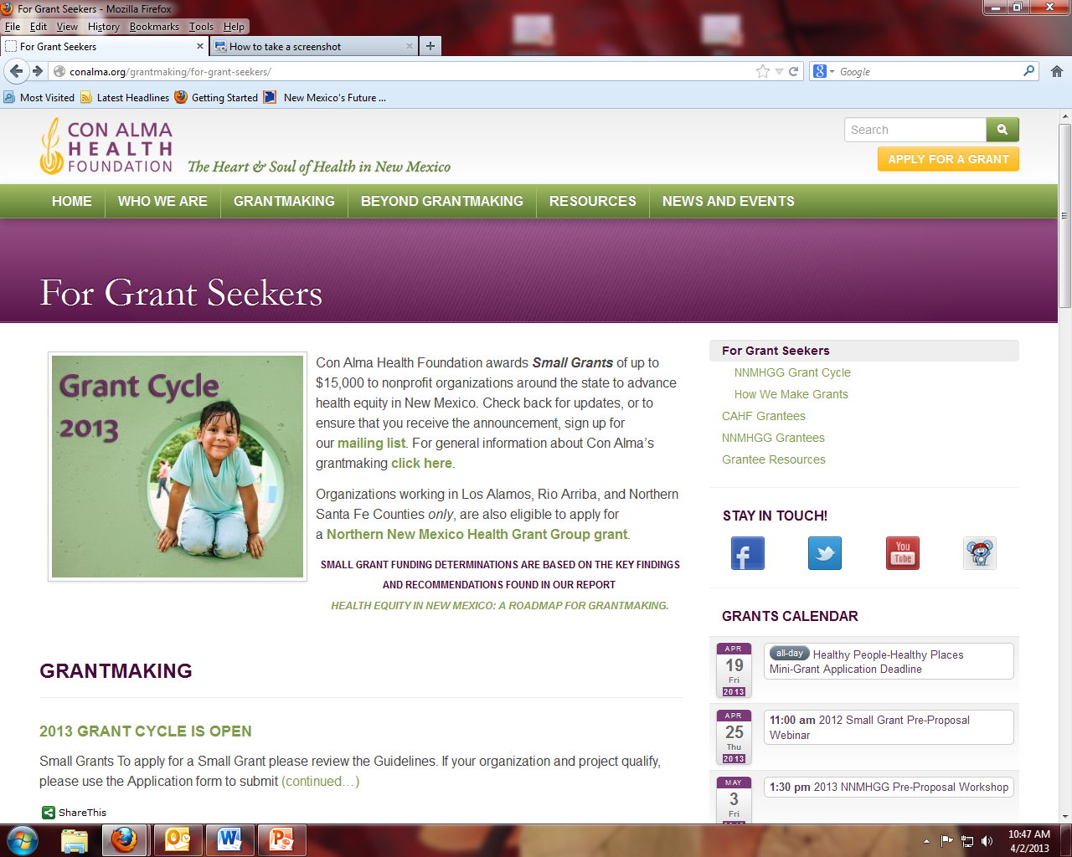
CAHF Application and Guidelines www.conalma.org

Slide 16
Restrictions: CAHF grants will not Fund
Direct Services
Lobbying
Scholarships/Fellowships
Fundraising Campaigns
Event Sponsorships
Clinical Research
Capital Expenses, including
Construction, renovation
Property
Equipment costing more than $5,000 per item

Slide 17
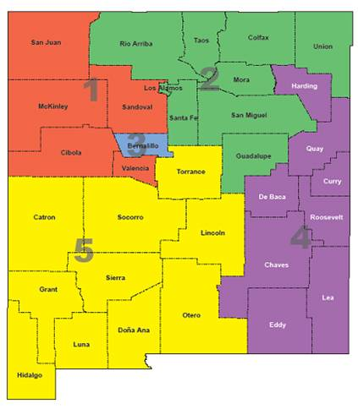
NM Regional Map

Slide 18
2013 Grants
CAHF Small Grants:
NNMHGG Grants:
Up to $15,000 per grant
$125,000 available
About 10 – 12 grants
Any county/counties or statewide
Deadline for application is Monday, June 3
Up to $15,000 per grant
$165,000 available
About 10 – 12 grants
Limited to Los Alamos, Rio Arriba & northern Santa Fe Counties
Deadline for application is Friday, June 21

Slide 19
Grant Review Process
Applications submitted
Initial review (Meet guidelines? Address priorities?)
Site visit and committee review
Committees recommend funding
Board determines awards

Slide 20
2013 Grant Cycle
Awards
(Nov. 2013)
Grant Agreements Completed
(Dec. 2013)
First Grant Check (Jan. 2014)
Interim Reports Due (July 2014)
Second Grant Check (July 2014)
Final Report Due (Jan 2015)

Slide 21
Con Alma Health Foundation (CAHF) Resources:
Visit Con Alma Health Foundation’s website for information on grant guidelines, funding priorities, and research reports at www.conalma.org:
Health Equity in NM: A Roadmap for Grantmaking and Beyond, March 2012
Making Health Care Reform Work for Small Business in New Mexico, March 2012
BluePrint for Health: Health Care Reform Implementation Work Plan for NM. Visit www.conalma.org or www.blueprintnm.org for report, & Resource Team Reports
Key Findings on New Mexico’s Oral Health Gap (2009 – 2010)
Project DIVERSITY, report on nursing pipeline project, July 2010
2010 Building a 21st Century Health Care Workforce in a Diverse Rural State: A Funder’s Perspective for Innovation & Impact of Health Career Pipeline Programs
2008 NNMHGG Report Data for Grantmaking: A Comparative Study of Community Health in Los Alamos, Rio Arriba and Northern Santa Fe Counties
2008 Women’s Health Inequalities in New Mexico: Challenges & Policy Options
Closing the Health Disparity Gap: A Roadmap for Grantmaking, 2006

Slide 22
General Resources
www.conalma.org – Con Alma Health Foundation
www.centerfornonprofitexcellence.org – Center for Nonprofit Excellence - resources/instructions for grant researches, etc.
www.nmag.org – Visit the New Mexico Association of Grantmakers (NMAG) website for information on philanthropy in NM, and NM Grantmakers Directory
https://sites.google.com/a/wellnesscoalition.org - The Wellness Coalition website Nonprofit Resource Center
www.nonprofitquarterly.org – Nonprofit Quarterly (NPQ) promoting an active and engaged democracy

Slide 23
Questions?
Michelle Gutierrez, Program Officer
505.438.0776, ext. 6
mgutierrez@conalma.org
Cecile LaBore, Information Manager
505.438.0776, ext. 5
clabore@conalma.org
Visit www.conalma.org for more information.

